Slide 1

Correlating Cell Type Transcriptome and Electrophysiology in V1
Mustache Whales!
Annie Vogel Ciernia & Claire Bomkamp

Slide 2
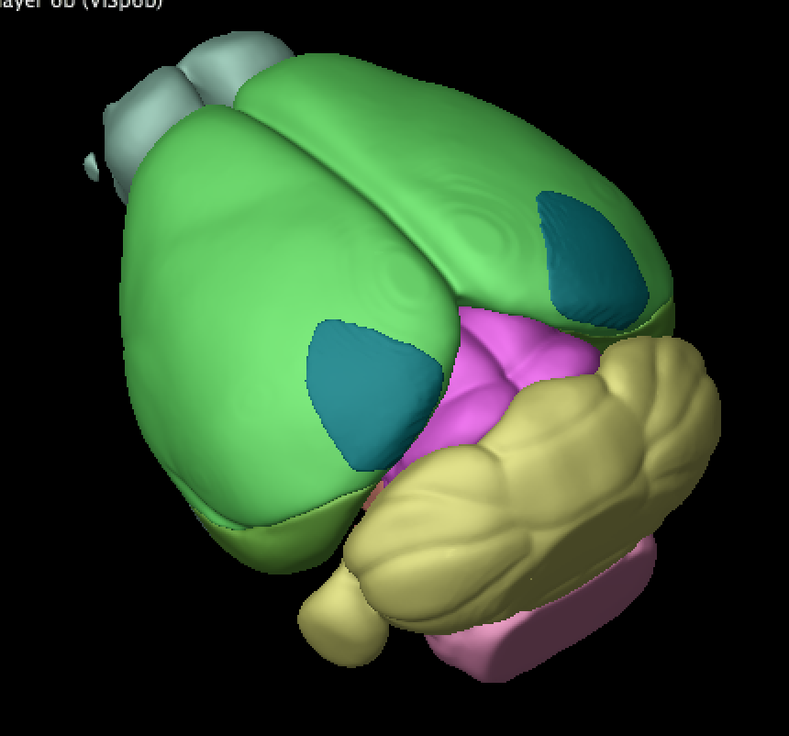
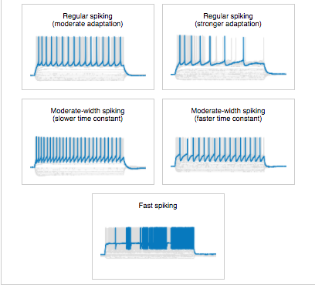
How is gene expression related to cellular function?
Transgenic
Cre-lines
Single Cell
RNAseq
Electrophysiology
Primary Visual Cortex
www.clker.com

Slide 3
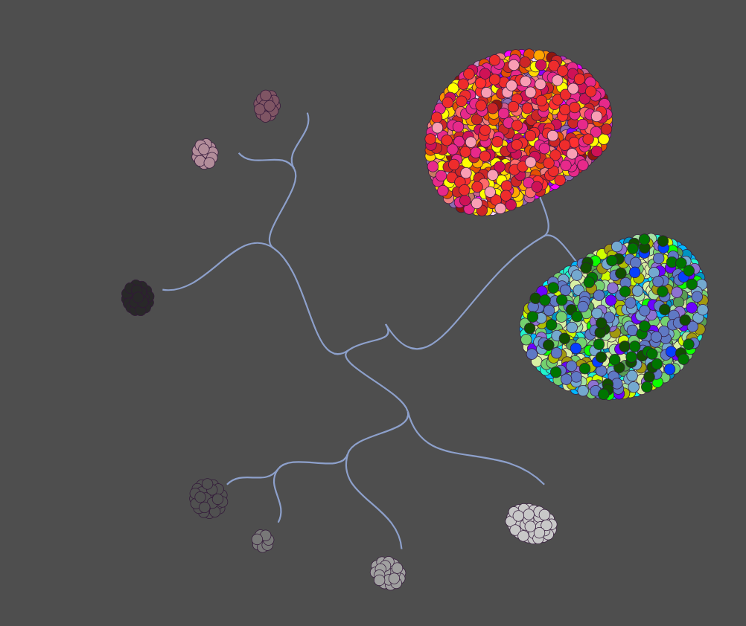
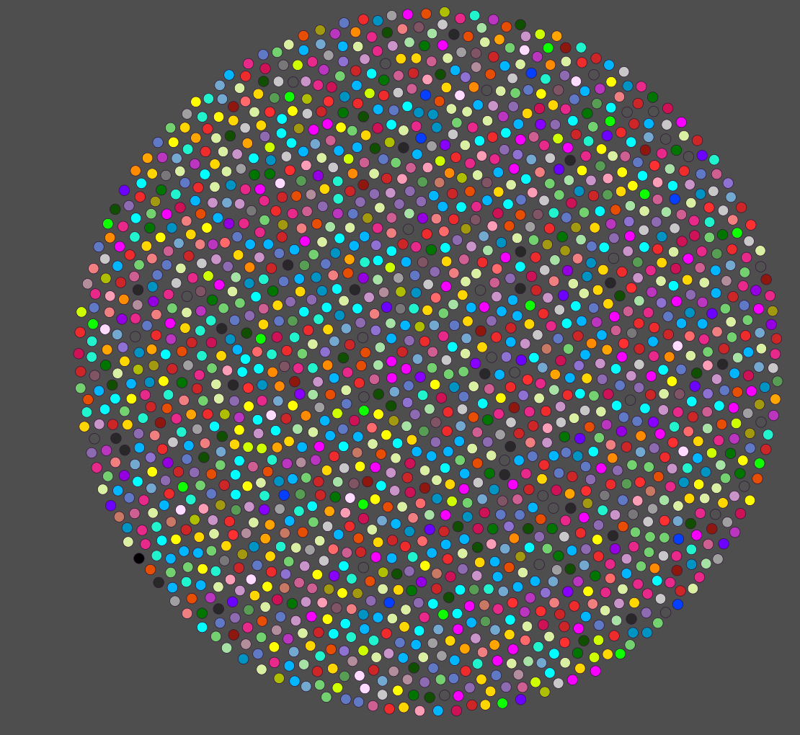
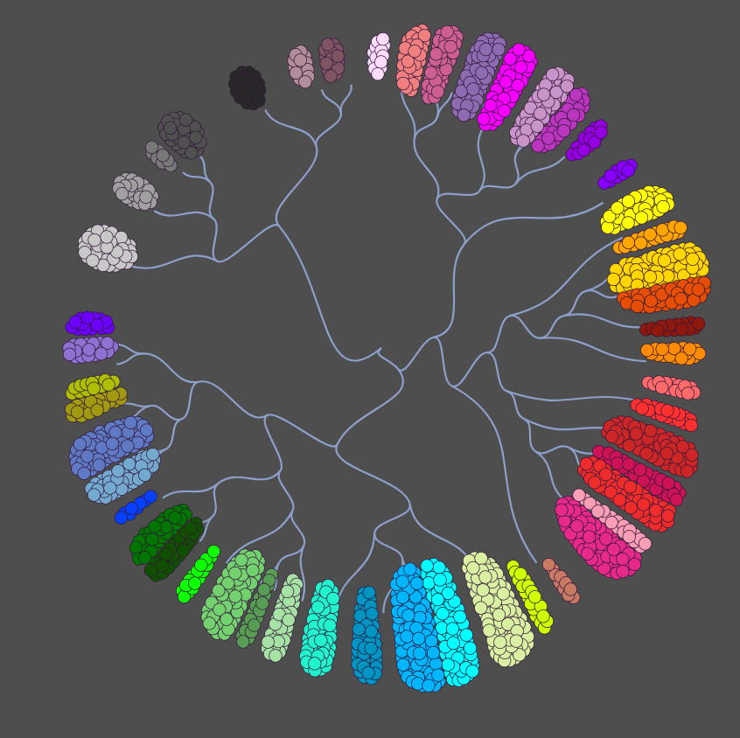
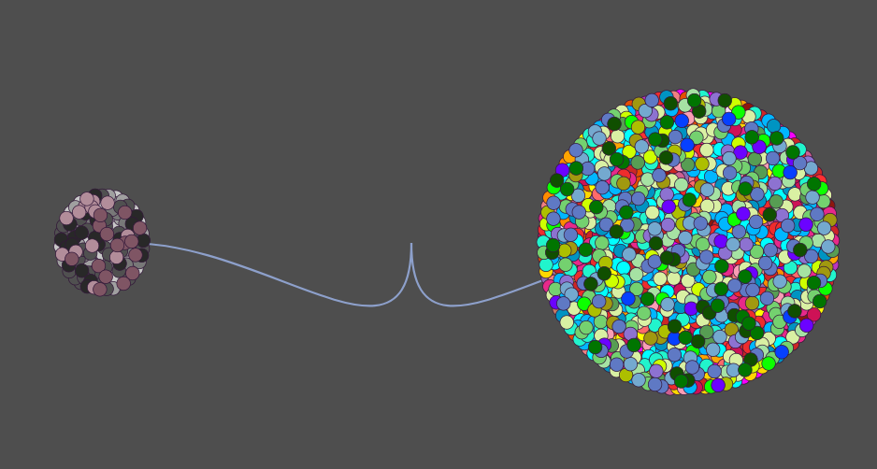

Slide 4
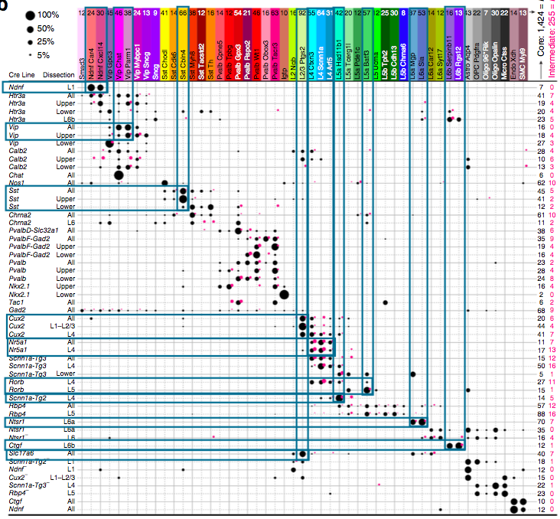
Some Cre-lines show multiple transcriptomic subtypes

Slide 5
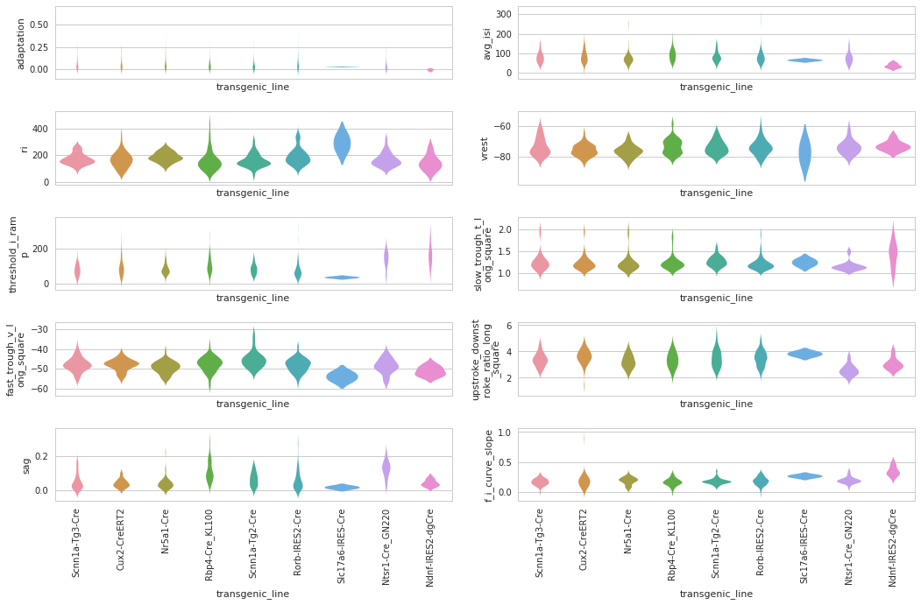
Does electrophysiology vary systematically across cell types?

Slide 6
Analysis #1: electrophysiology vs gene expression
Neurons
Average gene expression
E-Phys measure Y
Cell types defined by cre line & layer
Neurons
Average electrophysiology
Expression of gene X

Slide 7
Analysis #1: electrophysiology vs gene expression
Neurons
Average gene expression
E-Phys measure Y
Cell types defined by cre line & layer
Neurons
Average electrophysiology
Expression of gene X

Slide 8

Correlation doesn't imply causation, but it does waggle its eyebrows suggestively and gesture furtively while mouthing 'look over there'. (xkcd)

Slide 9

Importance of Multiple Comparisons: FDR Correction
If we choose an α value of 0.05 and we look at 21,000 genes, we can expect to pull out 1050 “significantly” correlated genes for each measure we look at, just by random chance!
https://en.wikipedia.org/wiki/Franklin_D._Roosevelt

Slide 10
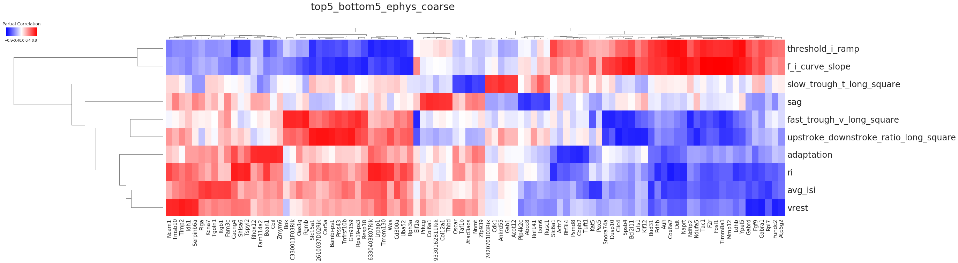
Partial Correlations: All Genes x Ephys Measures
Genes
Top five r values for positive and negative partial correlations (across I/E) between gene expression and ephys measures for cre line & L1-4 vs L5-6

Slide 11
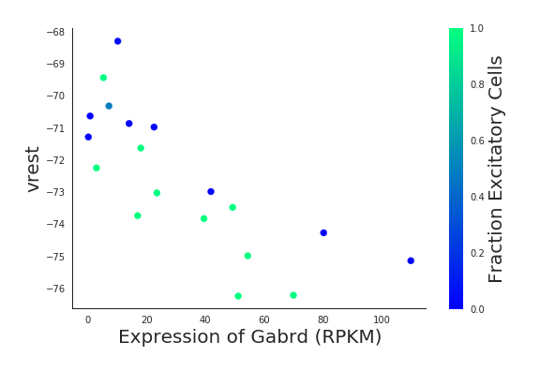
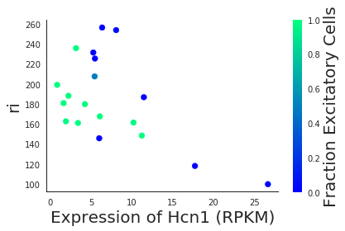
Success story: Receptors & Channels!
GABAR receptors
correlate with resting potential
KCNC and HCN channels
correlate with many ephys metrics

Slide 12
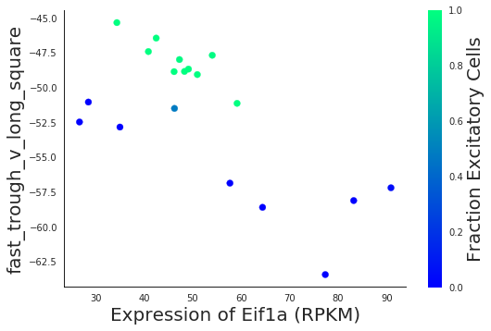
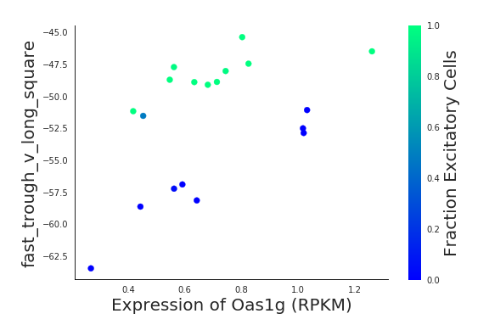
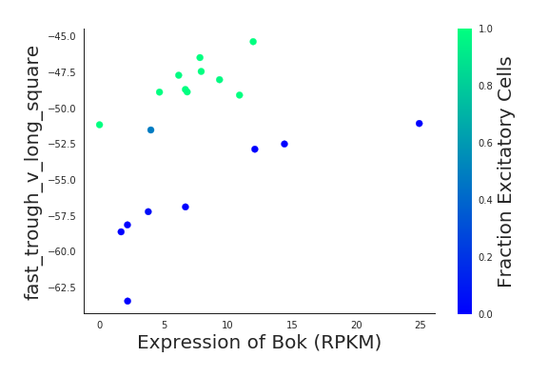
Some gene-ephys relationships are similar across excitatory and inhibitory cells
E-Phys measure Y
Expression of gene X

Slide 13
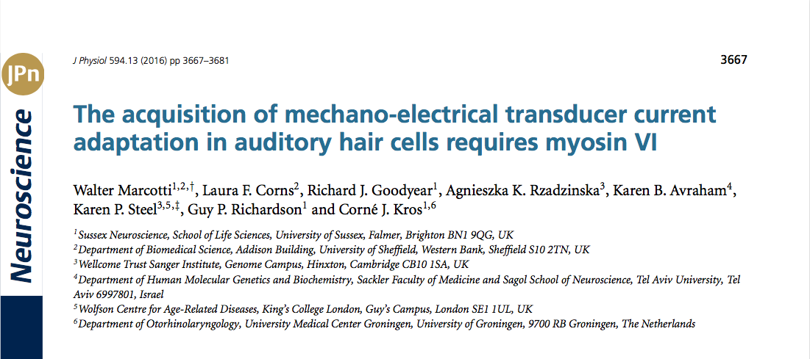
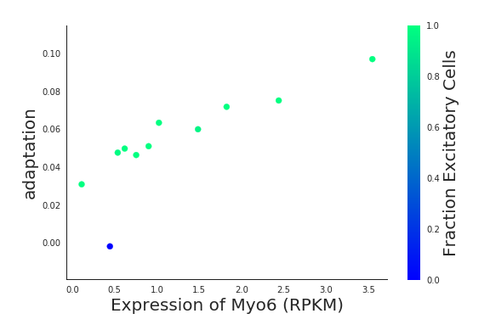
Success story: Myosin 6!

Slide 14
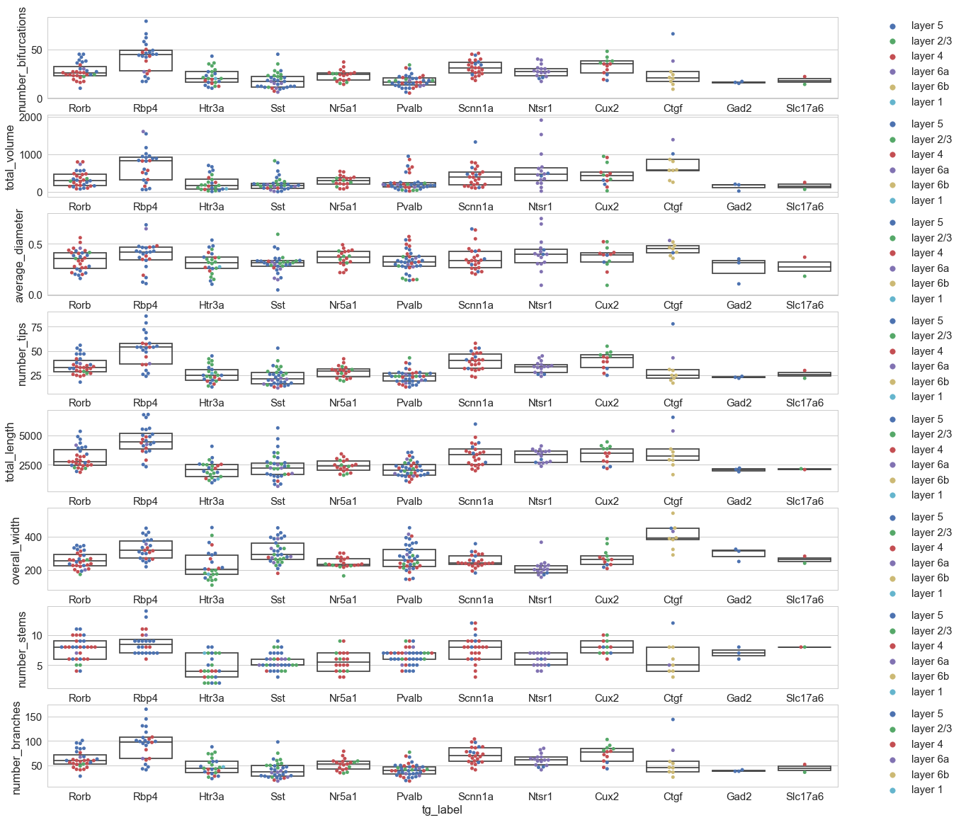
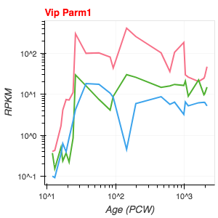
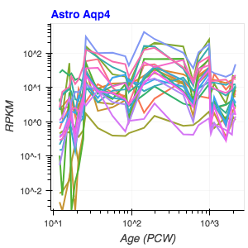
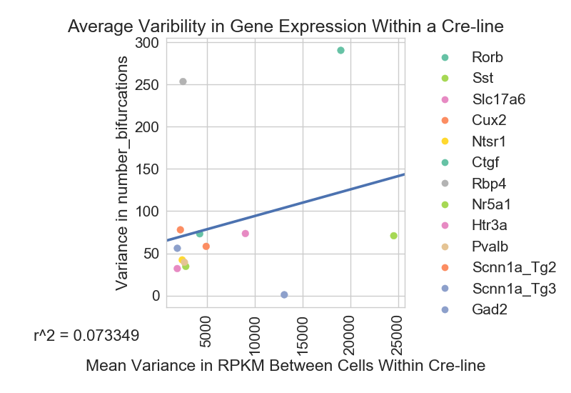
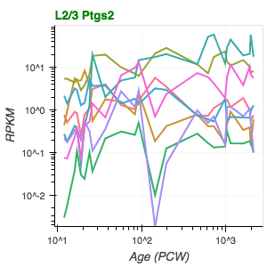
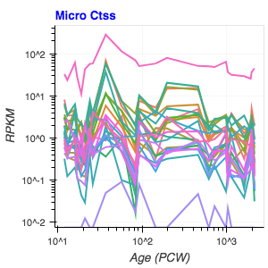
Other Analysis:
Are morphology measures correlated with gene expression?
Is variation in gene expression correlated with variation in transcriptionally defined cell subtypes within a cre-line?
Can expression of cell type marker genes be used to identify when that cell type is first expressed during brain development?

Slide 15

Future Directions:
Functional studies to validate identified genes
Gene Ontology & pathway analysis of correlated genes
Explore other brain regions
Science so hard!

Slide 16
Conclusion:
PatchSeq is going to be awesome!!!

Slide 18
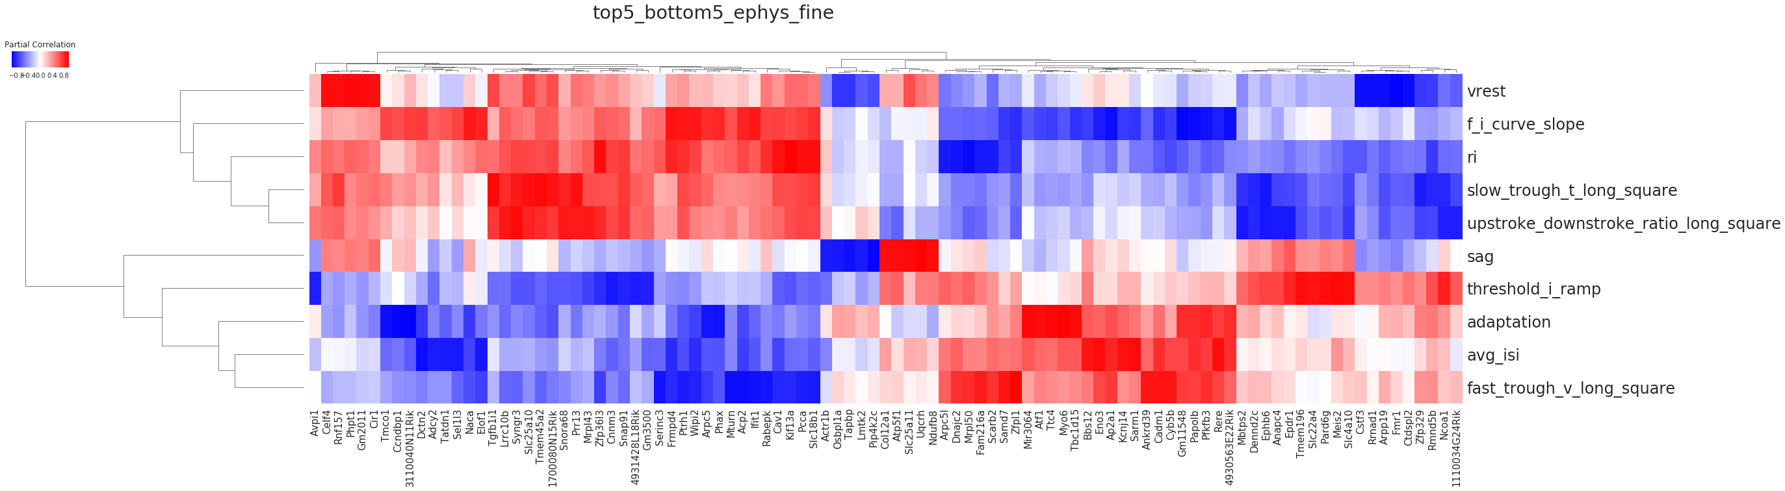
Potentially Interesting Genes!
By cre line & layer (mostly excitatory)

Slide 19

Transcriptome profiling across human brain development
13 developmental stages in 8 -16 brain structures
Preliminary Analysis: V1
Map Signature Genes for each cell type to human developmental data
Identify patterns of developmental expression

Slide 20
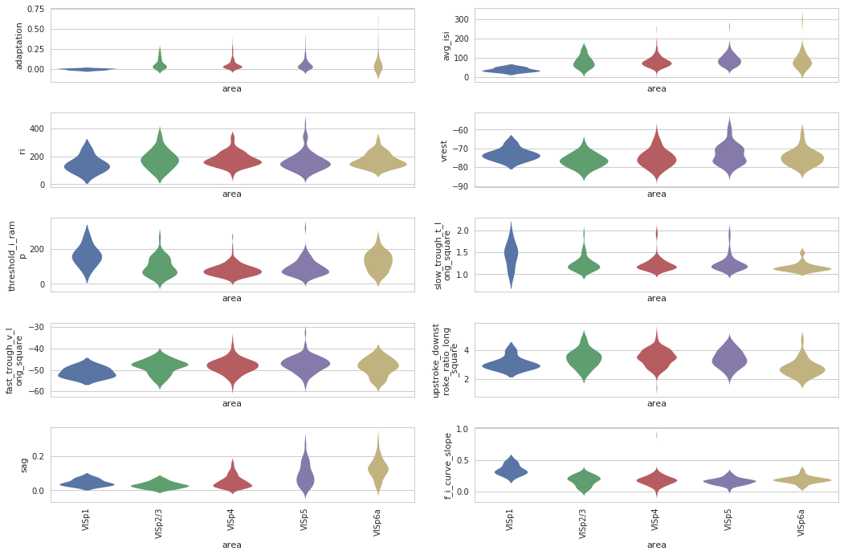
Does electrophysiology vary systematically across cell types?

Slide 21
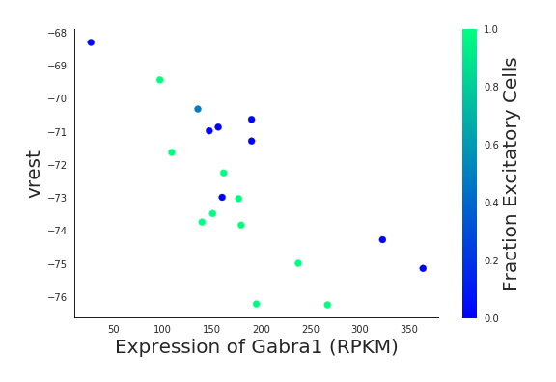
Success story: GABA receptors!
KCNC and HCN channels
correlate with many ephys metrics

Slide 22
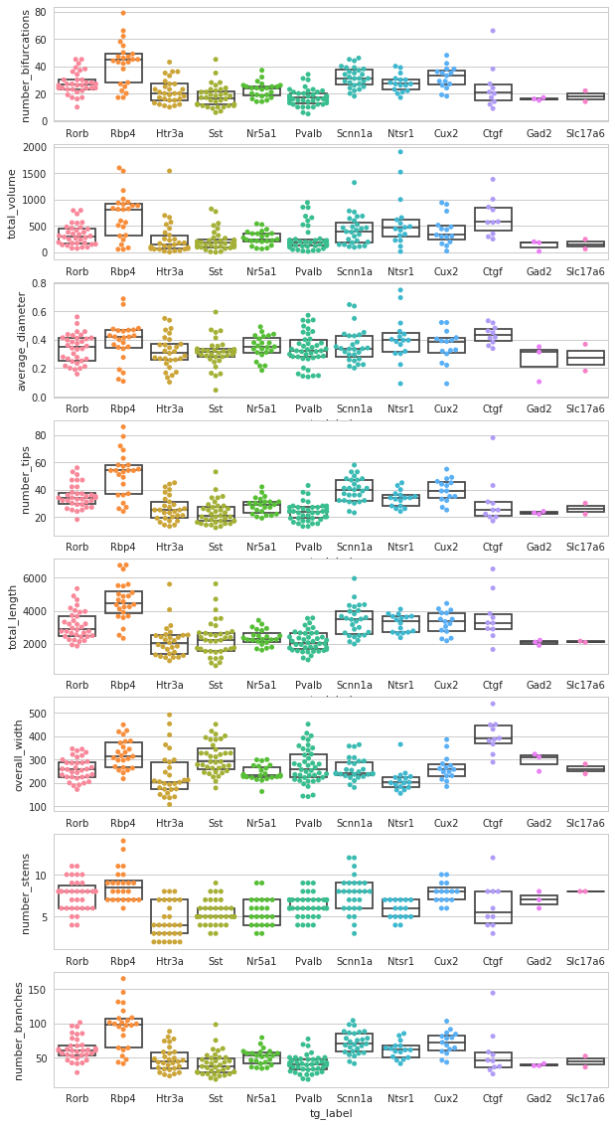
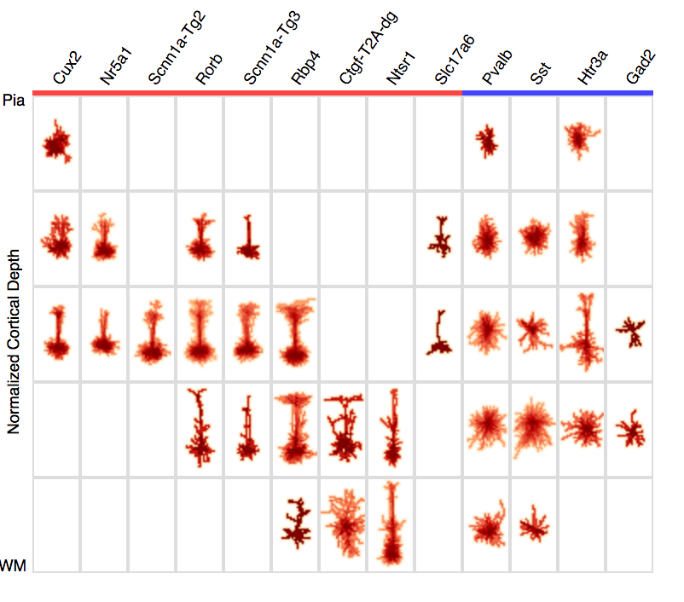
Cell Types Database Morphology
Examine features of neuronal morphology for each cre-line in V1:
number_bifurcations
total_volume
average_diameter
number_tips
total_length
overall_width
number_stems
number_branches

Slide 23
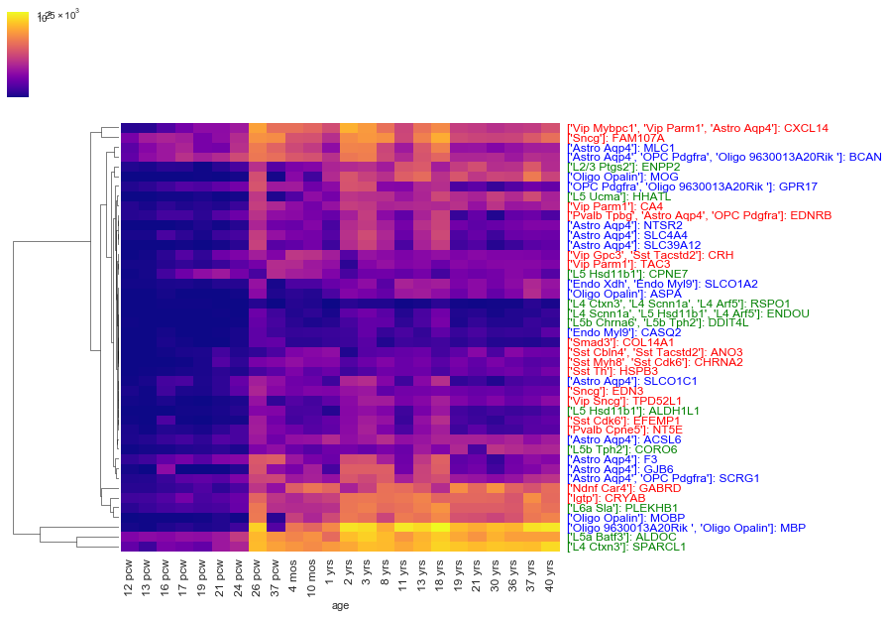
Developmental time course of cell type signature gene expression
Excitatory
Inhibitory
Glia, other
(note that some genes are classified as “signature” for more than one cell type)
Cell type(s): Gene
Inclusion criteria:
-Classified as “signature genes” by Tasic et al. 2016
-Human homologue present
- Expression increased by > 50x between 12 pcw and 3 yrs

